Slide 1
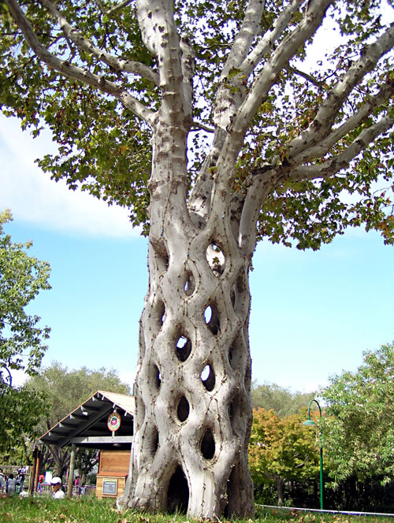
Grafting Methods
Week #5

Slide 2
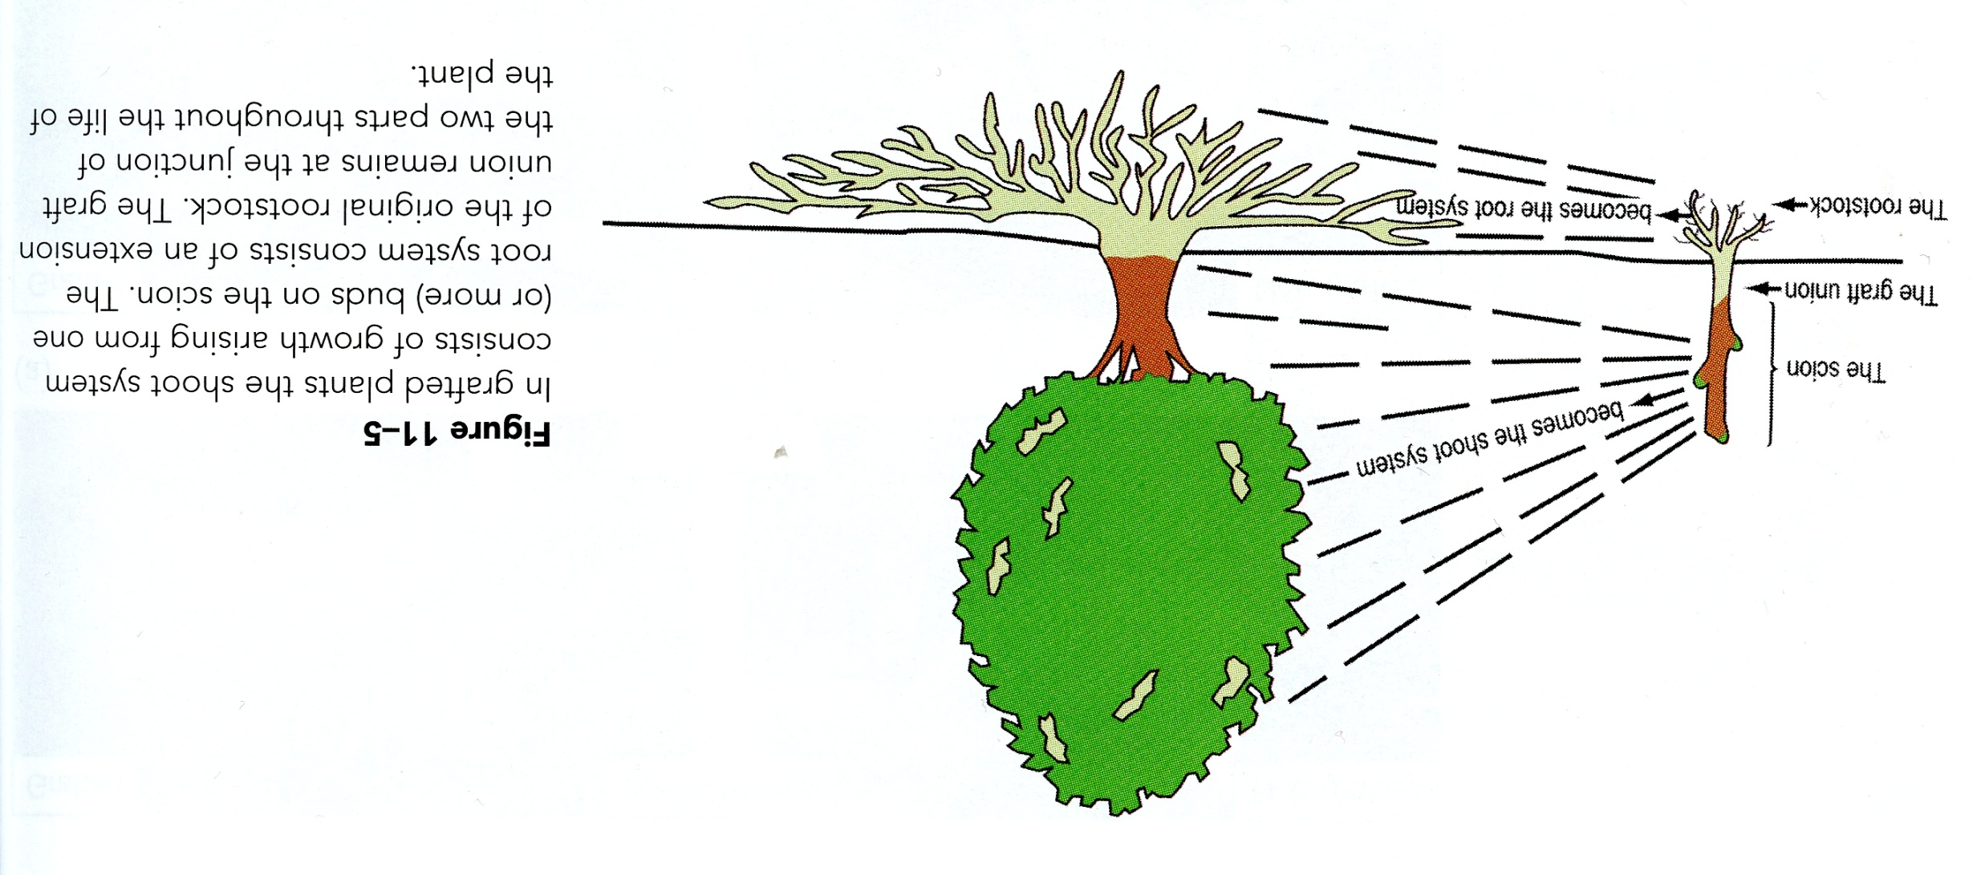
Grafting

Slide 3
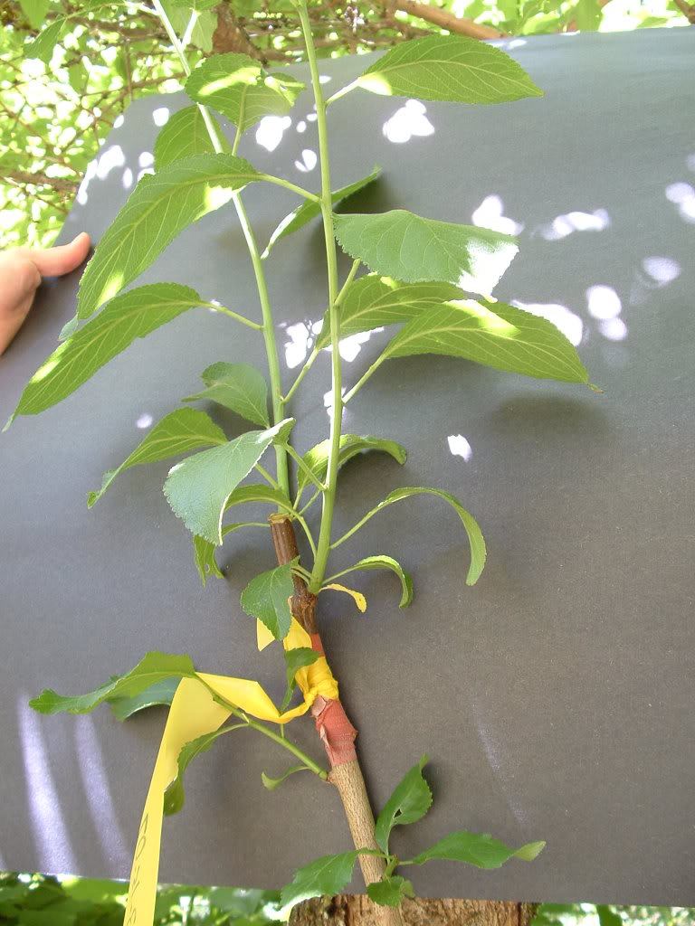
Grafting Methods

Slide 4
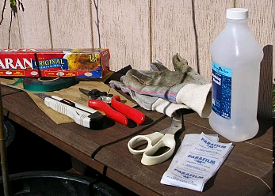
Material Required
Grafting knife
Pruners
Razor blade
Disinfectant (Listerine,
rubbing alcohol)
Grafting Tape (electrical, parafilm, Polyethylene)
Budding strips
Grafting wax
Compatible plants

Slide 5
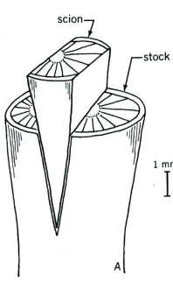
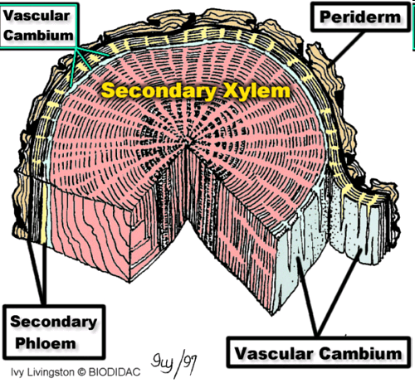
The Graft Union

Slide 6
Field Grafting
Performed in the field early March through April
Scion must be dormant
Rootstock just starting to grow

Slide 7
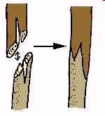
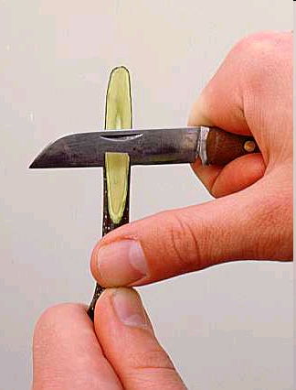
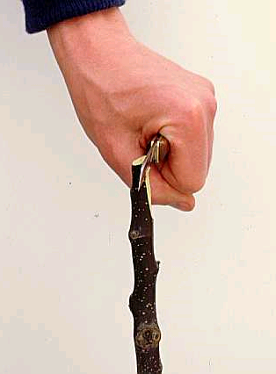
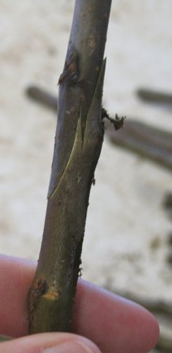
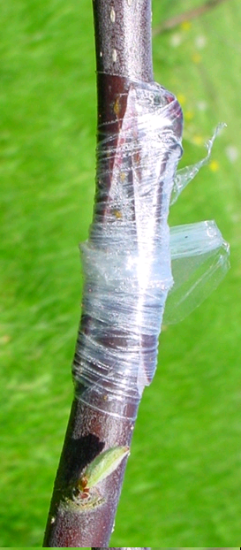
Whip & Tongue
Successful for materials ¼ - ½ in. diameter
Scion and rootstock of equal diameter
Generally done when the rootstock and
scion are dormant
Used specifically for deciduous trees

Slide 8
Cleft Graft
Most often used in top-working trees or grafting a rootstock considerably larger than the scion.
It is done in early spring before the buds start to swell.
The scion is cut from one year old wood and should include three buds.

Slide 9
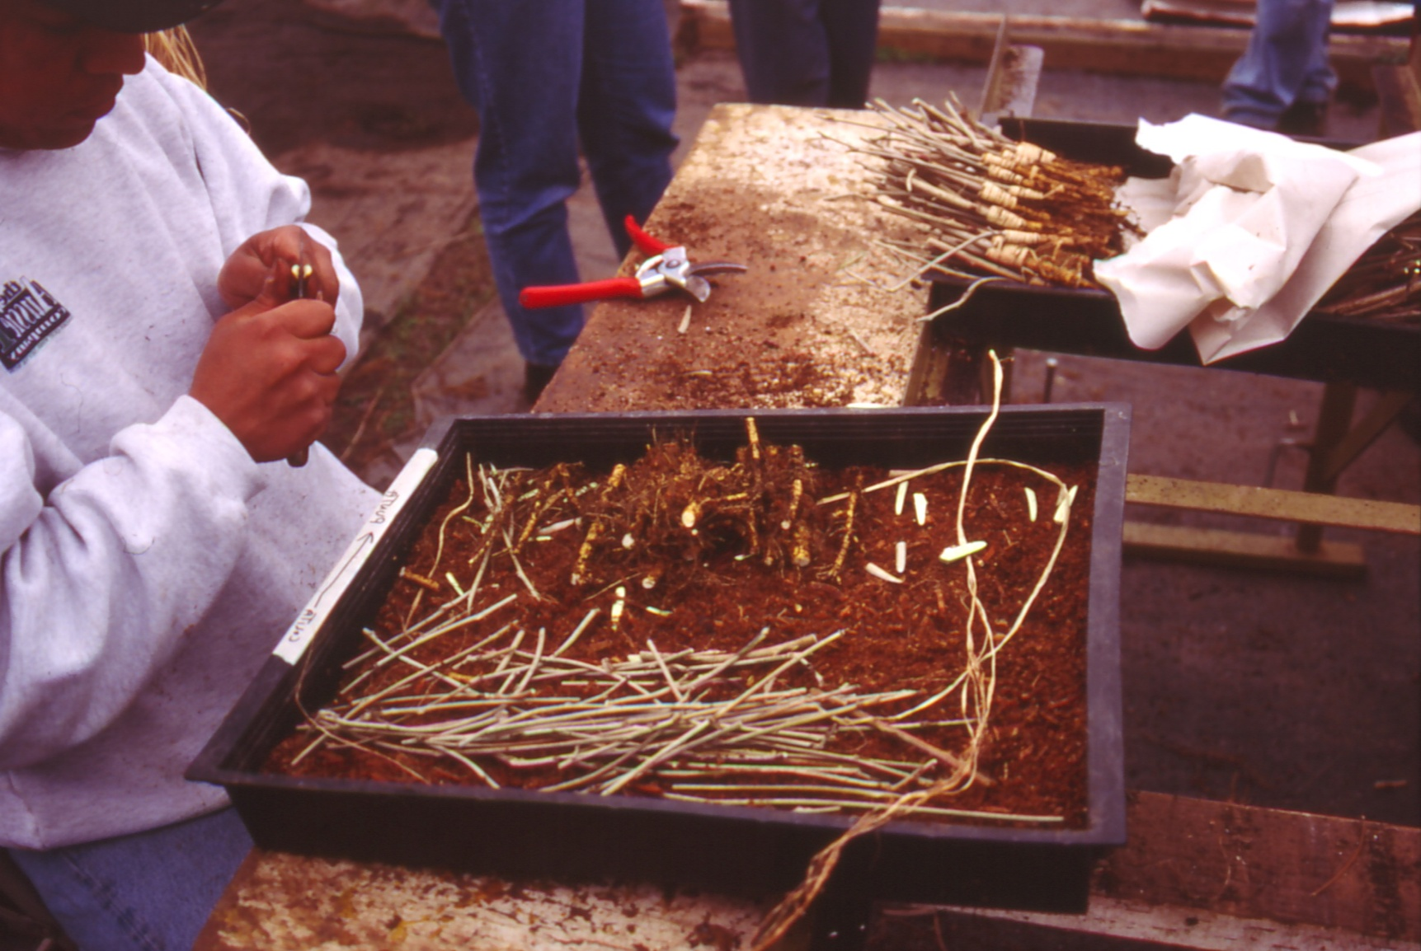
Apical Wedge or Cleft Graft

Slide 10
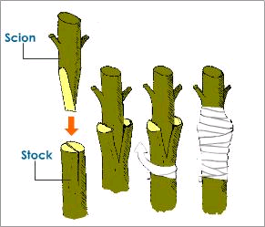

Slide 11
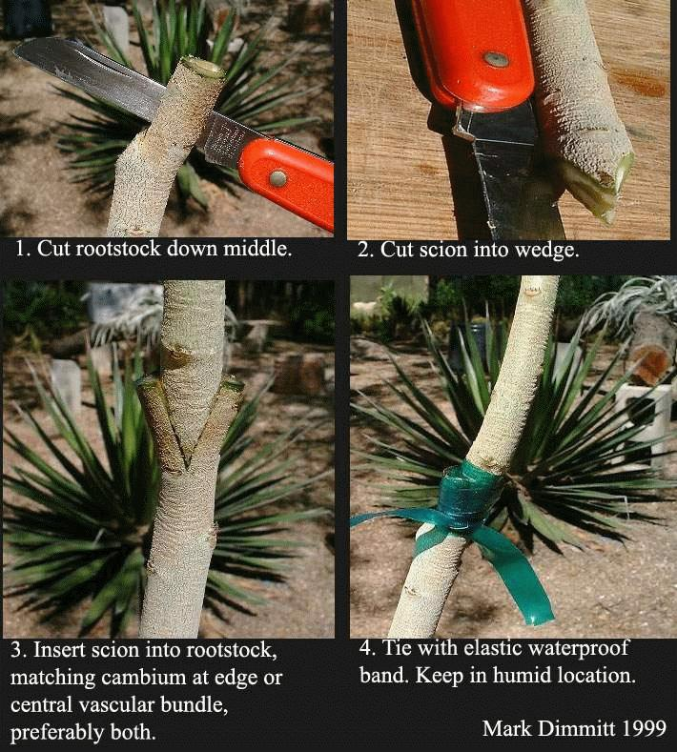
Cleft Graft Cont....
1. Cut rootstock down middle
3. Insert scion into rootstock,
matching cambium at edge
2. Cut scion into wedge
4. Tie with elastic waterproof band

Slide 12
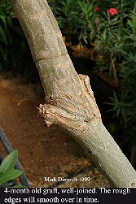
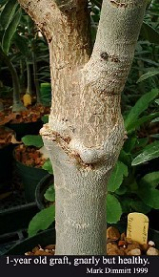
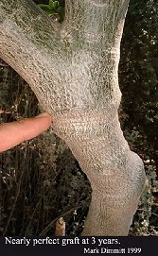
b
Successful Cleft Graft
Four month old graft.
The rough edges will
smooth over time.
One year old graft.
Nearly perfect graft
after three years.

Slide 13
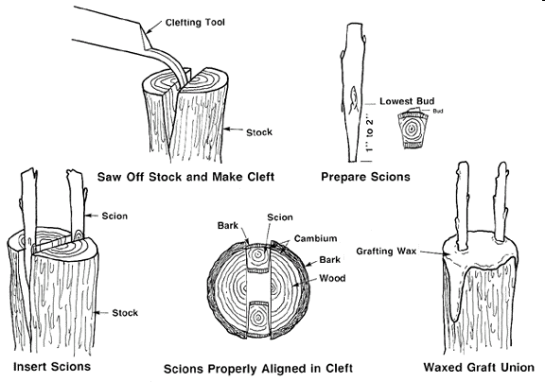
Cleft Graft Cont....

Slide 14
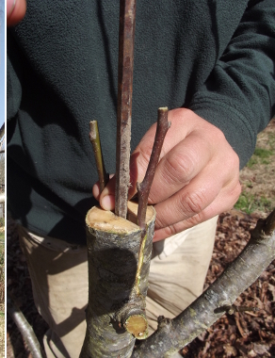
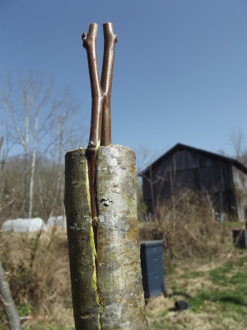
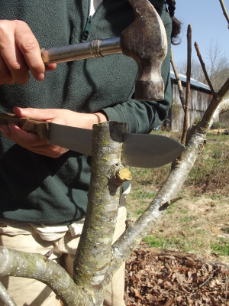

Slide 15
Budding
Performed in the summer months only
Buds must be from current season wood, dormant and fully developed
The bark must “slip” away from the wood when cut
T-Budding is performed mid-July to late August
Chip budding mid-July to September
Warm temperatures allow the bud to heal faster
Notes:
‘’

Slide 16
Budding Techniques
Bud sticks collected in mid July
Use current season growth only
Remove leaves leaving a short piece of petiole attached
Sticks are bundled wrapped in paper and plastic and placed in a cooler
Typically performed on 2-year old rootstock planted in field rows or potted rootstock

Slide 17
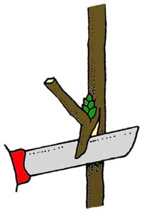
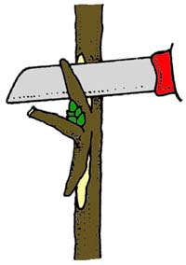
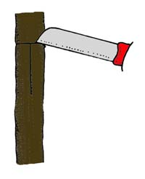
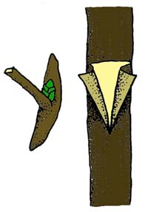
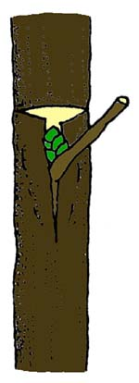
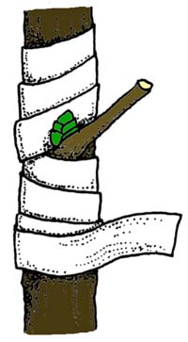
T-Budding
It is done by choosing and cutting a bud from one plant and attaching it to another plant.
Scion piece is reduced to a single bud
Rootstock must be actively growing (bark is slipping)
Confined to Roses, some fruits and ornamental plants.

Slide 18
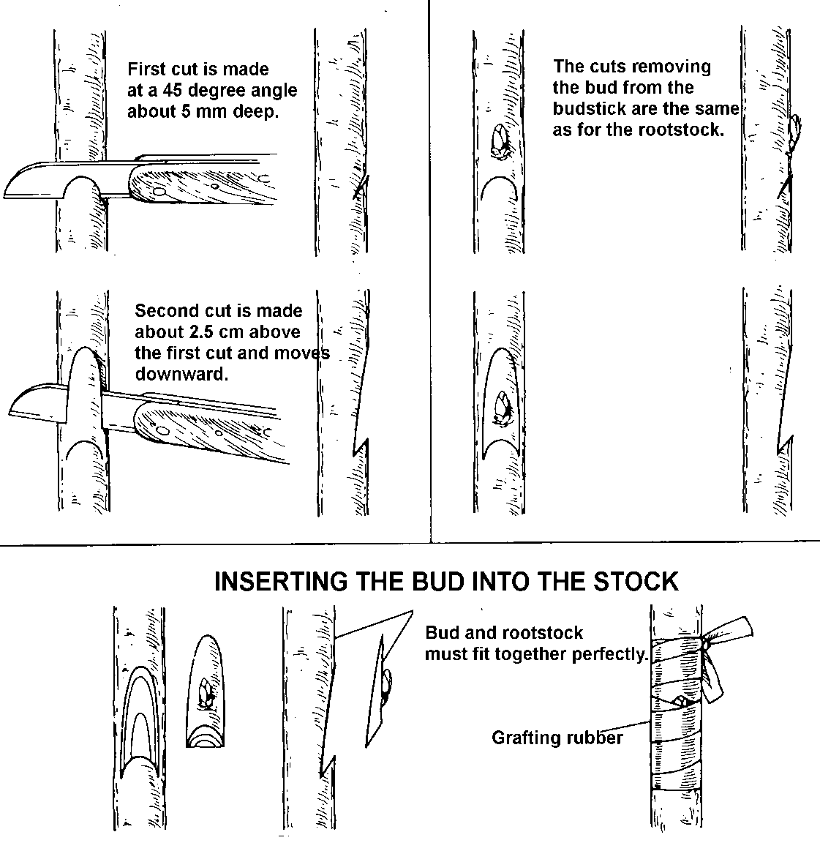
Chip Budding

Slide 19
Bench Grafting
Performed when the rootstock is growing in a pot
Done inside a greenhouse
Grafter is sitting at a bench
Some tree species ex: Japanese Maple can be grafted at any time of the year
Other shade trees budded in early spring
Conifers must be grafted when dormant – December to February

Slide 20
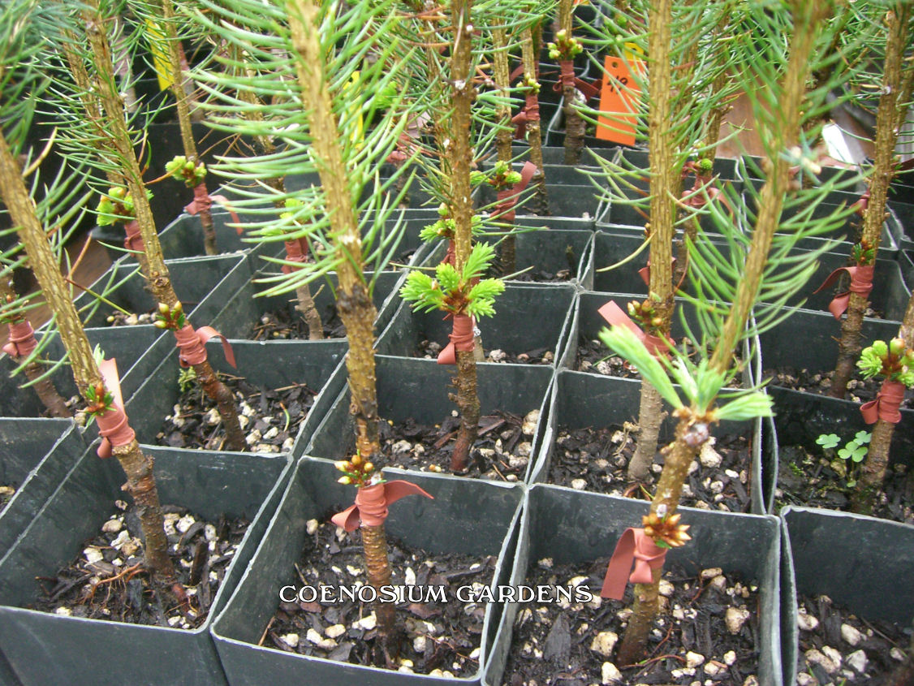
Conifer Bench Grafts
http://www.cnos.biz/nursery/production.htm

Slide 21
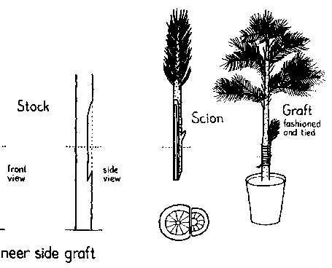
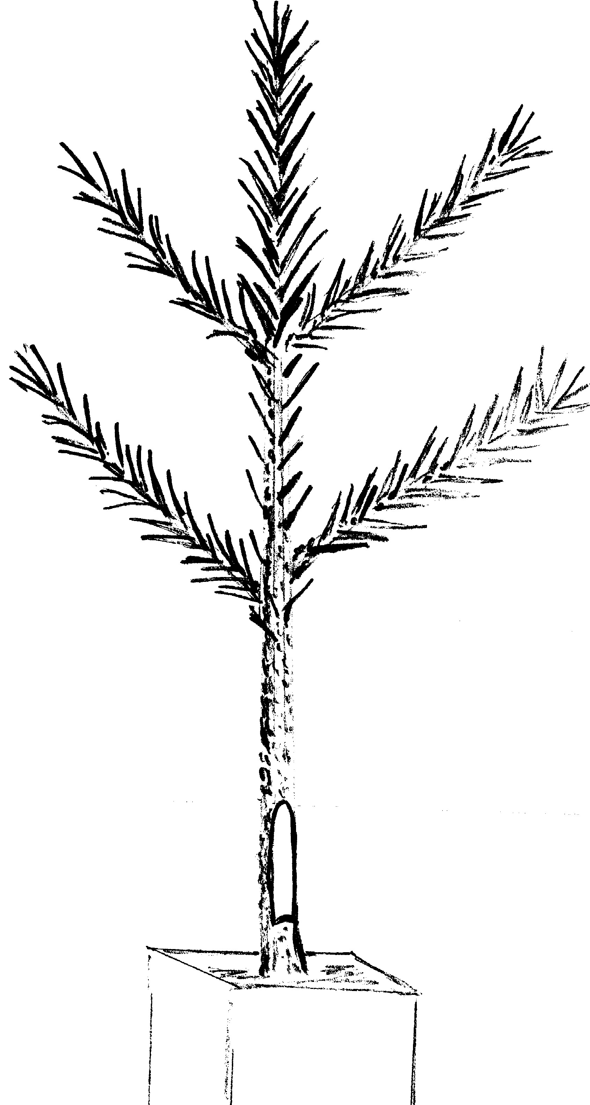
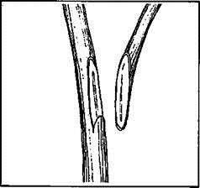
Side Veneer Graft cont....
Needles and lower branches are removed on rootstock

Slide 22
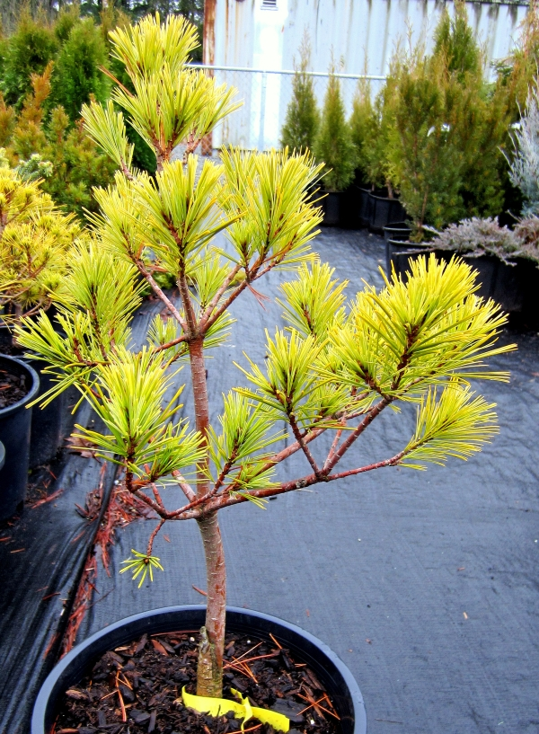
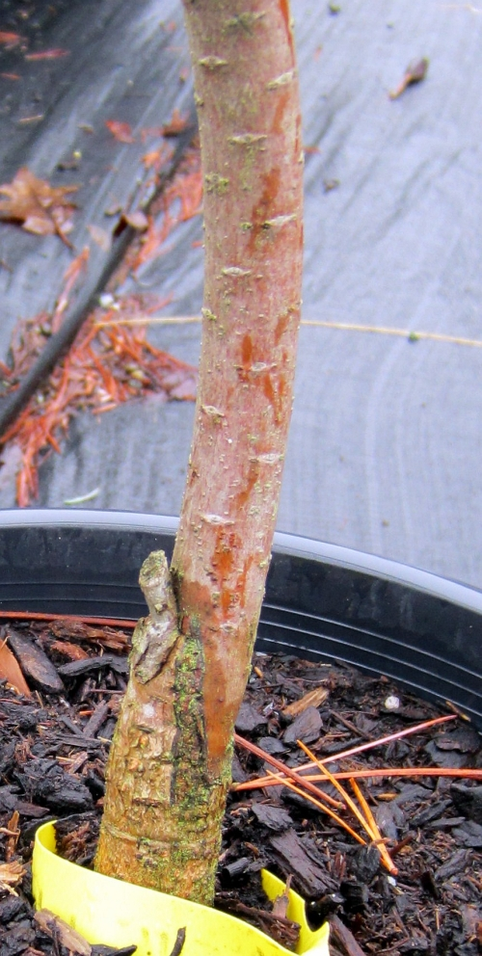

Slide 23
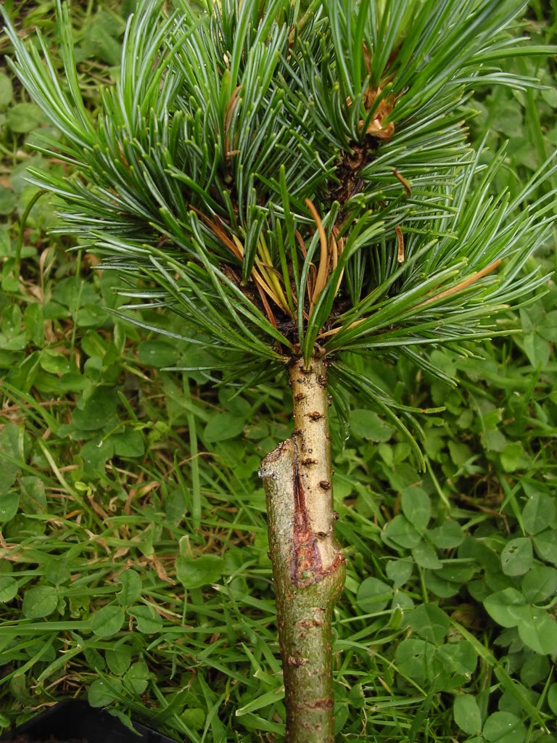
http://forums.gardenweb.com/forums/load/conif/msg0218145320851.html

Slide 24
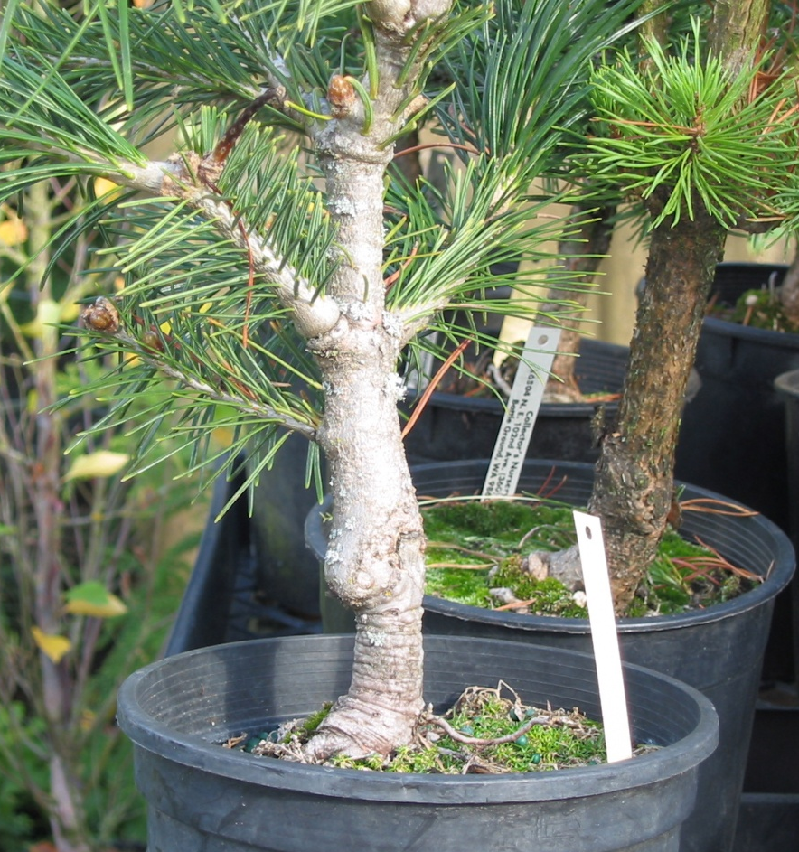
Poorly Matched Graft
Rootstock may be growing more slowly than scion cultivar

Slide 25
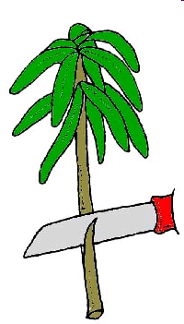
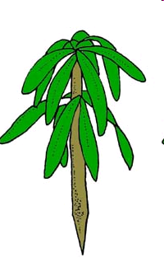
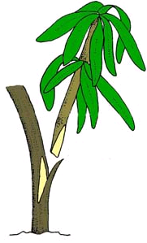
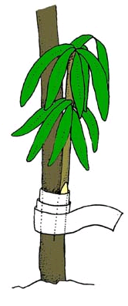
Side Wedge Bench Graft
Make a cut into the rootstock at an angle 1/3 of the way into the stem
Prepare the scion by cutting the base into a wedge
Insert the wedge into the cut of the rootstock ensuring cambium alignment
Hold the union together as you tie with a rubber band

Slide 26
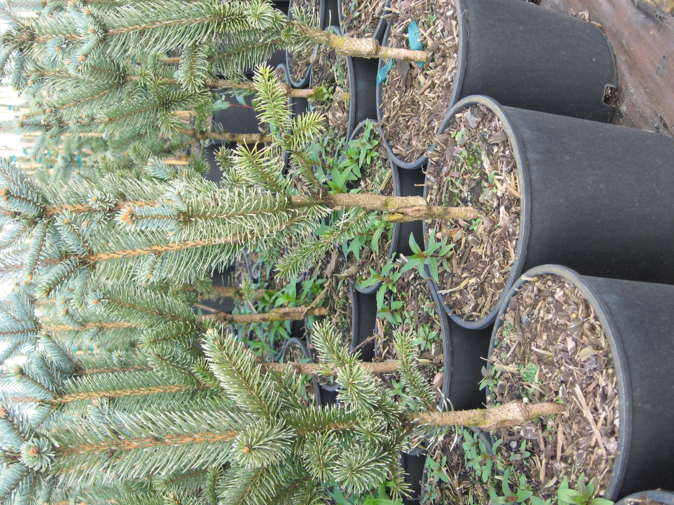

Slide 27
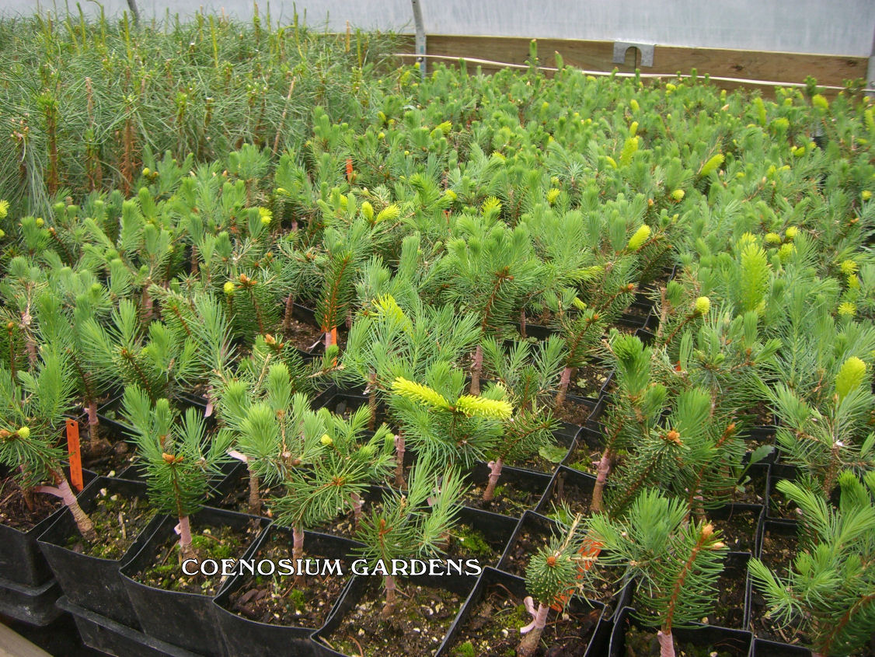
Picea abies ‘Gold Drift’ grafts just breaking dormancy
http://www.cnos.biz/nursery/Production/CGGreenhouse307.jpg

Slide 28
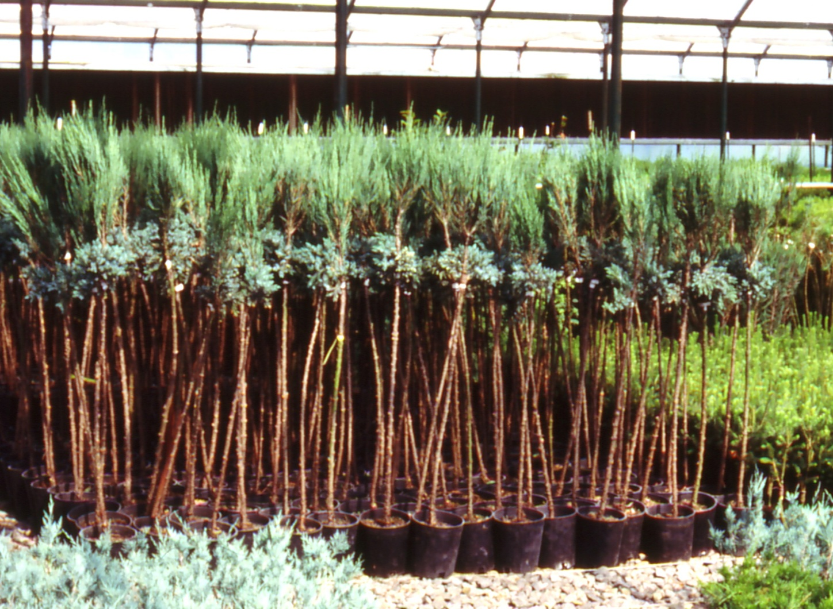
Grafted Standards
Side Wedge or Veneer Graft

Slide 29
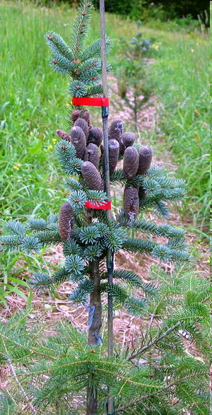
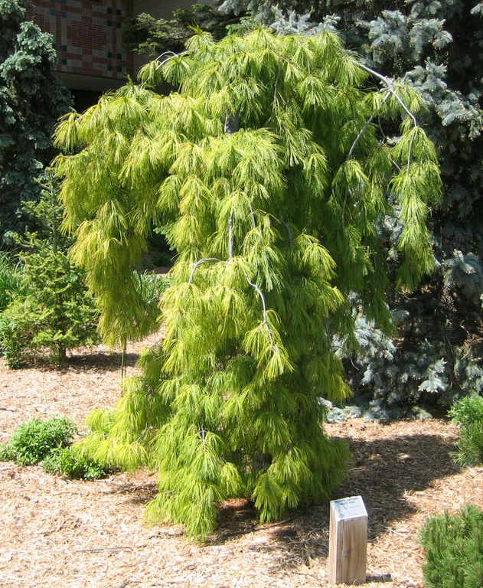
Weeping White Pine –
Pinus strobus “Pendula”
Cone bearing tree

Slide 30
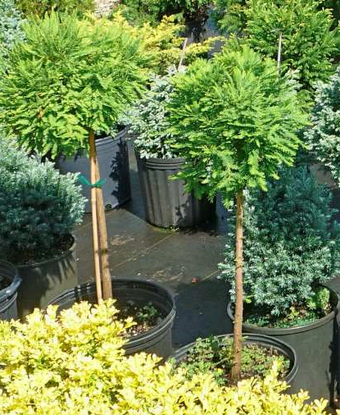
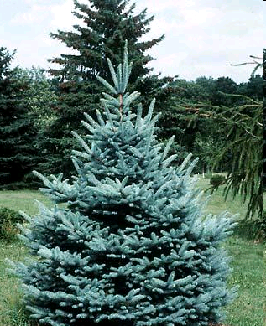
Bald Cypress
Dwarf Colorado Blue Spruce

Slide 31
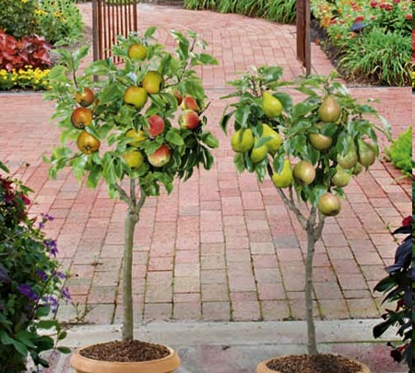
Apple - Malus sp.
Pear – Pyrus sp.

Slide 32

Questions?!!!
Hmm… A definite case of incompatibility!!

